Slide 1
WindowsPopup
Angular JS Module
https://github.com/ervinn/windowsPopup-dev

Slide 2
What is WindowsPopup? What is it for? Who should use it?
It is an Angular JS Module.
Angular Data Binding does not work between Parent and Child windows.
WindowsPopup handles Data binding between Parent and Child Browser window.
https://github.com/ervinn/windowsPopup contains two files :
windowsPopup.js => Angular Js Code (User should not modify)
windowsPopupConfig.js => Configurations (User can modify this)
Angular developers can load and use this to handle data bindings between Parent and child browser windows.

Slide 3
Features (Two main features)
Open a Modal Window.
Open a small Modal (bootstrap) window.
Open a large Modal (bootstrap) window.
Configure any size of Modal window.
Open a new browser window.
Toggle open and close the child by clicking a “wnp-popup” link.
Data binding between Parent and Child.
Automatic data binding between Parent and Child.
Controlled/confirmed data binding between Parent and Child.
More levels of data binding (Child as a Parent data binding).

Slide 4
How Modal (wnp-pop) directive works to open a Modal Window?
<wnp-pop url=http://..... wnp-pop-name=“large |small”>
. . . Any Html here …
</wnp-pop>
Right click in “Any Html here..” space a Modal window specified on the url will be opened.
With “wnp-left-click” attribute the Modal window will be opened with the left mouse click.
With “wnp-dbl-click” attribute the Model window can be opened by a double click.

Slide 5
Con’t : How “wnp-pop” works?
<wnp-pop url=http:/. wnp-pop-name=“large | small” wnp-left-click >
. . . Any Html here … These text will be hidden by the Modal window.
The Modal window will be opened by the left mouse click inside the wnp-pop tag.
</wnp-pop>
<wnp-pop url=http://. wnp-pop-name=“large |small” wnp-dbl-click >
. . . Any Html here … These text will be hidden by the Modal window.
The Modal window will be opened by double click inside the wnp-pop tag.
</wnp-pop>

Slide 6
How opening a new window (wnp-popup) directive works?
<wnp-popup url=http://.. “ wnp-name=”<name of the window>”
wnp-title=“Title of the Window”
width=“xxx”
height=“xxx”
wnp-auto-update=“true | false”
wnp-toggle-open-close=“true | false”
left=“xx”
top=“xx”
wnp-on-open=“onOpen(wnpName)” => User Callback function during open
wnp-on-close=“onClose(wnpName)” => User Callback function during close
</wnp-popup>

Slide 7
Con’t : Open new window (wnp-popup). How data binding works?
Data binding in the html in both Parent and Child:
In the Parent :
<input type=“text” wnp-model=“item_one” ng-model=“parentDat” />
In the Child :
<input type=“text” wnp-model=“item_one” ng-model=“childDat” />
Data binding using Parent controller : In The Parent :
.controller('ParentController', function($scope, wnpToChild) {$scope.bgrColor = 'lightgray'; wnpToChild.addOneSharedModel($scope, 'item_three', 'bgrColor');
In the Child :
<select wnp-model="item_three"
ng-model="brgColor"
ng-options="col for col in ['red', 'blue', 'green', 'lightgray']">
</select>

Slide 8
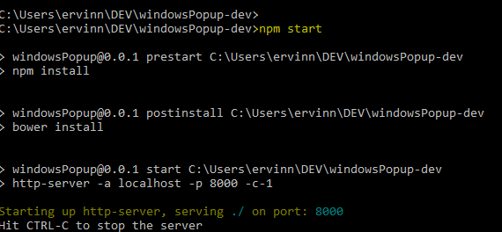
Development Environment
For the development environment you need Git and npm software installed on your computer.
To set up development environment clone :
> git clone https://github.com/ervinn/windowsPopup-dev
> npm install
The run the sample application:
> npm start
In the browser go to :
http://localhost:8000/app/index.html

Slide 9
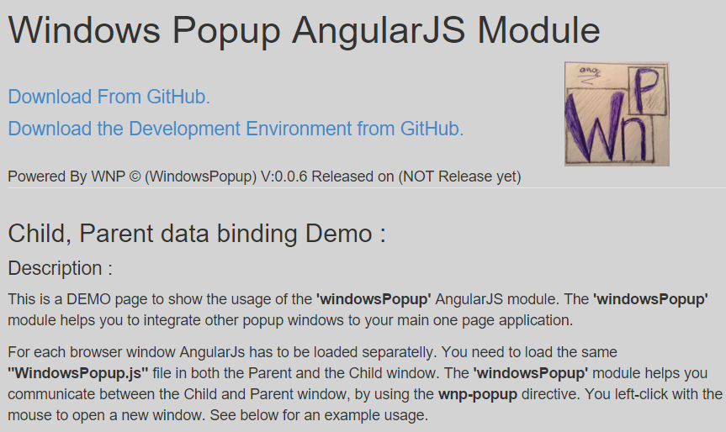
Con’t : Development Environment Demo App.
You should see this:

Slide 10
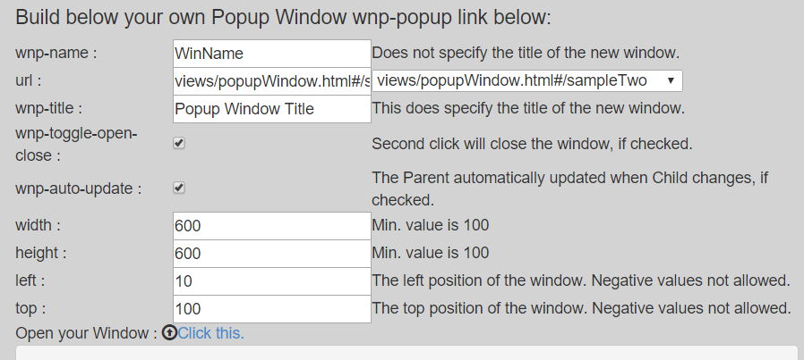
Con’t : Development Environment Demo App. Build your own Popup.

Slide 11
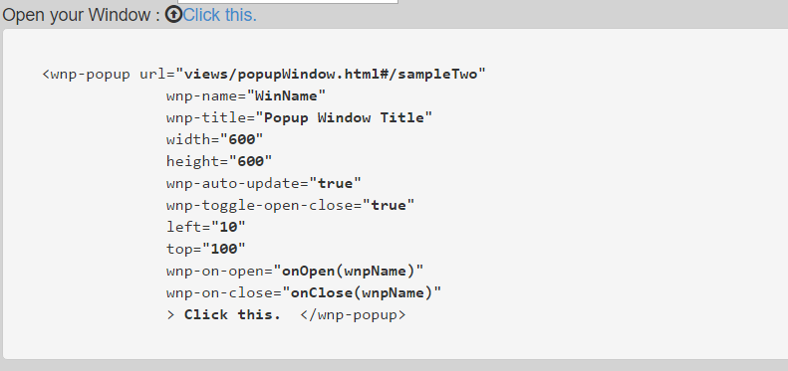
Con’t : Development Environment Demo App. Build your own Popup.
See result as you type :
When you ready click

Slide 12
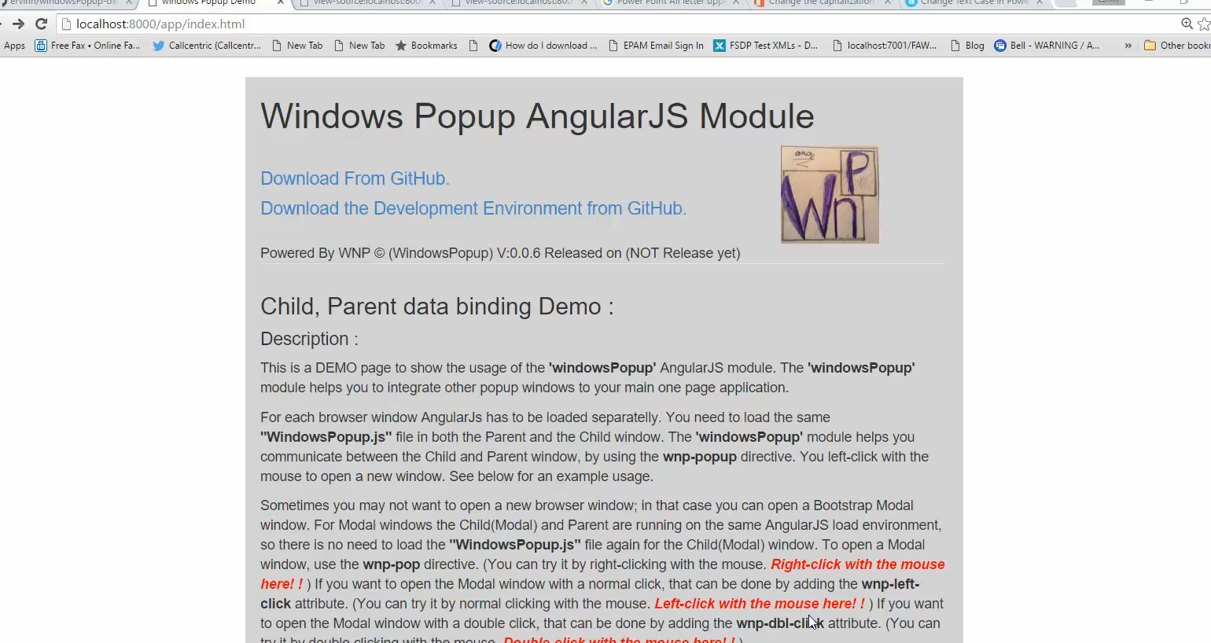
Con’t : Development Environment Demo App. Build your own Popup.

Slide 13
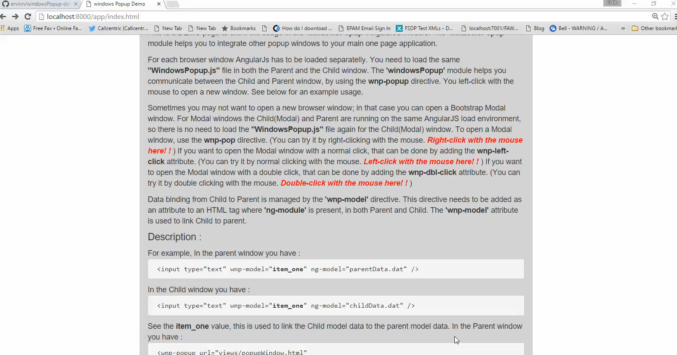
Con’t : Development Environment Demo App. Open Modal Windows.

Slide 14
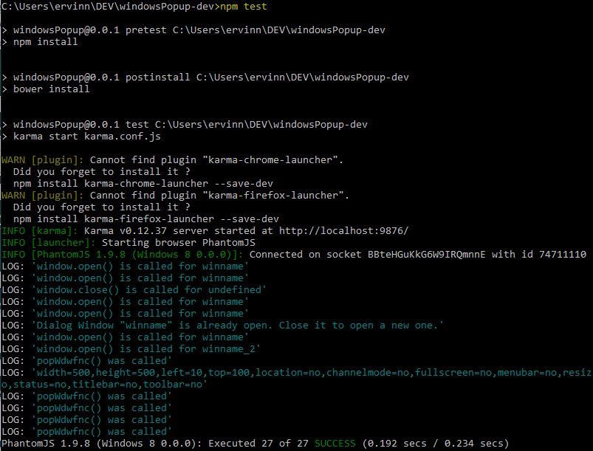
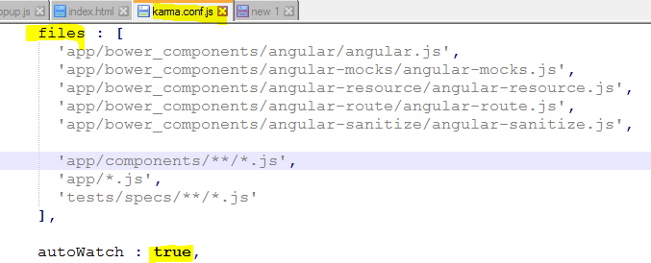
Con’t : Development Environment Unit tests.
To run the Unit test type:
> npm test
The test rerun if files are changed
Test config file is “karma.conf.js”

Slide 15
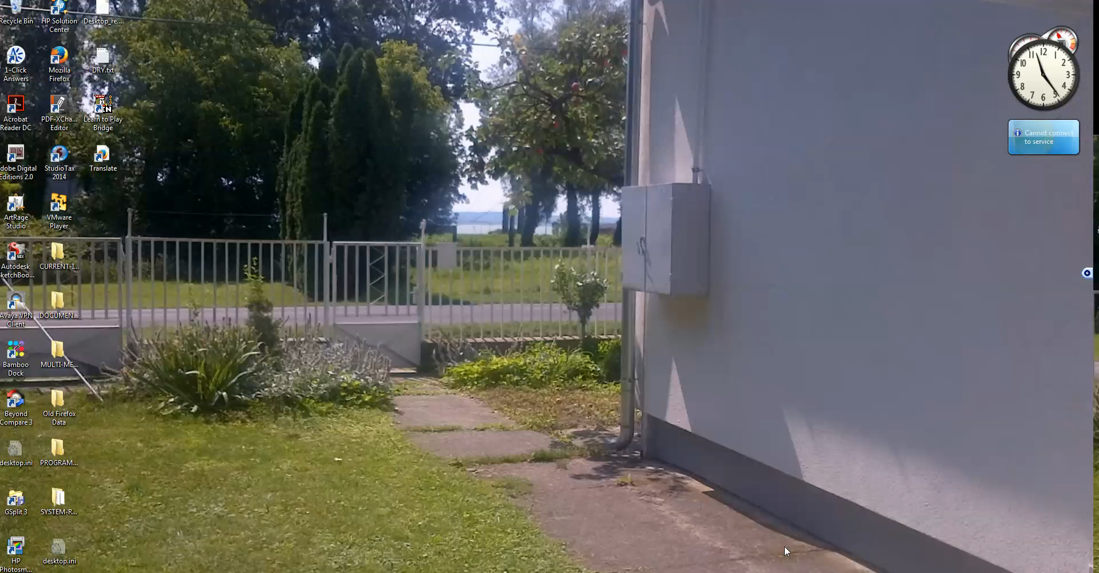
Con’t : Development Environment E2E Test. (Protractor)

Slide 16
Configuration for WindowsPopup

